Slide 1
Data Science 4

Slide 2
Overview
Linear Regression
Polynomial Regression
Nearest Neighbor Classification and Regression
Overfitting and Underfitting
…..
…..
simple
model complexity
complex

Slide 3


Correlation
Popov
cuteness
furriness

Slide 4
Description versus Prediction
Correlation is describing the data.
We want to predict data,
therefore we model the data

Slide 5
What is a model?
In machine learning, a model takes the feature(s) as input and generates as output a label estimate
Input: furriness
Output: estimate of cuteness
Evaluation of the model: difference between estimated and true cuteness values

Slide 6
What is a suitable model?
a line!
Popov
cuteness
furriness

Slide 7
What is the best model (line)?
Popov
cuteness
furriness

Slide 8
Answer: the best fitting line
deviations from the model = error

Slide 9
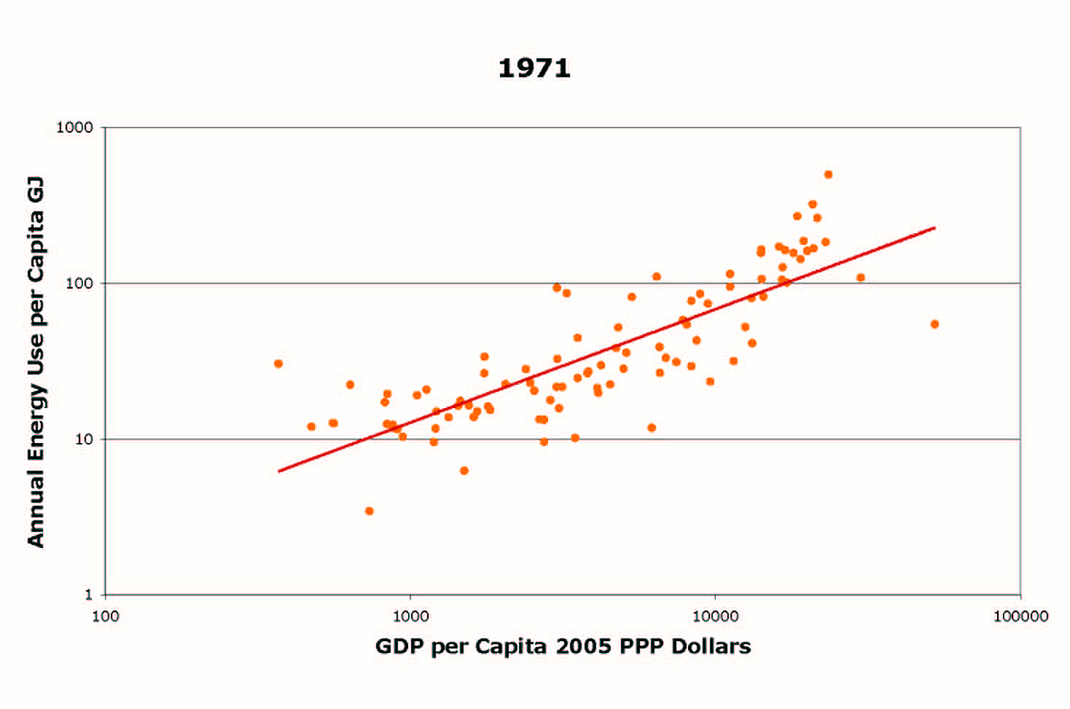
Can be determined automatically…

Slide 10
Regression Equation
CUTENESS = a FURRINESS + c
a is the slope of the FURRINESS line —> positive value
c is a constant

Slide 11

Adding a second feature…
cuteness
barkness

Slide 12
and a second model
cuteness
barkness

Slide 13
Multivariate regression
cuteness
cuteness
furriness
barkness

Slide 14
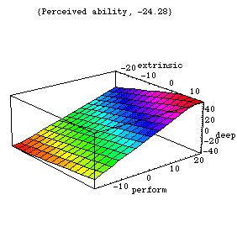
Multivariate model (regression surface) can be automatically determined

Slide 15
Multivariate Regression Equation
CUTENESS = a FURRINESS + b BARKNESS + c
a is the slope of the FURRINESS line —> positive value
b is the slope of the BARKNESS line —> negative value
c is a constant

Slide 16
How to measure the prediction power?
Linear regression is still model fitting, i.e., description rather than prediction

Slide 17
Prediction with Linear Regression
Fit the model to a subset of the data (training)
Test the predictions on the remaining data
TRAIN
TEST

Slide 18

Training/Test Set: Selection Bias
The selection of the training and test sets can affect the test results
positively —> test set contains “easy” instances
negatively —> test set contains “hard” instances
“easy” test instances
“hard” test instances

Slide 19
Cross Validation Evaluation Procedure
Procedure to remove the training/test set selection bias
General idea:
Perform multiple classification or regression experiments with the dataset.
In each experiment, select a different partitioning of the dataset into training and test sets.
Average over the prediction accuracies obtained in the experiments.

Slide 20
3-fold Cross Validation

Slide 21
k-fold Cross Validation
Often k is defined as a suitable (large) number
Examples
Dataset of 1000 instances —> k=10, because 10-fold cross validation yields training sets of 900 instances and test sets of 100 instances.
Dataset of 777 instances —> k=7, resulting in 666/111 partitioning
Leaving-one-out cross (LOO) validation: k = number of instances

Slide 22

Nearest Neighbour Classification

Slide 23
Two Classes (blue & red)
Feature 2
Feature 1

Slide 24
Nearest-neighbour classifier
Given a set of labeled instances (training set), new instances (test set) are classified according to their nearest labeled neighbour

Slide 25
Nearest Neighbour Classification
RED
BLUE
RED
Feature 2
BLUE
Feature 1

Slide 26
k-NN
In the k-NN classifier, the parameter k represents the number of labeled neighbours considered
k = 3: test examples are assigned the labels of the (majority of the) 3 nearest neighbours
k = N: test examples are assigned the labels of the (majority of the) 3 nearest neighbours
For even N in case of an equal number of nearest neighboring labels of two classes: flip a coin

Slide 27
k determines the
“model complexity”
The model in k-NN is the decision boundary that separates the classes (In regression, the model is the line that fits the data)
Smaller k leads to more complex decision boundaries

Slide 28
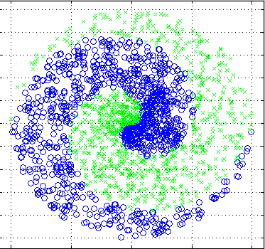

Slide 29
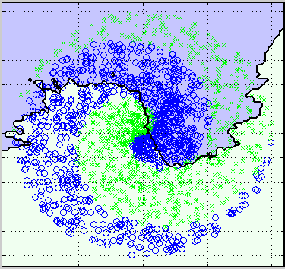
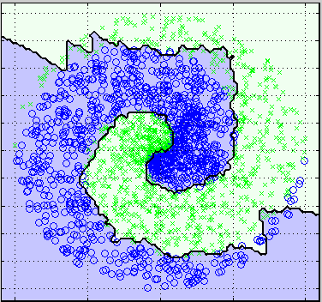
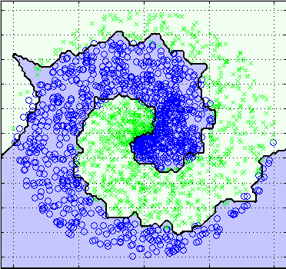
k = 100
k = 10
k = 1
Increasing model complexity

Slide 30
How to determine model complexity?
Depends on complexity of the separation between the classes
Start with the simplest model (large k in kNN), and increase complexity (smaller k)

Slide 31
Polynomial Regression
………..
The building blocks are formed by the xn (the larger n, the more complex the shape).
The values of the a’s determine the presence of the building blocks.

Slide 32
Polynomial Regression
Increasing the complexity (flexibility) of the regression equation, leads to more complex models
CUTENESS = a FURRINESS + b BARKNESS² + c
…..
…..
simple
model complexity
complex

Slide 33
Polynomial Expansion (complexity parameter)

Slide 34
Lowest Complexity (p.e.=1): Underfitting

Slide 35
Bit more complexity (p.e.=2): Best fit

Slide 36
Even more complexity (p.e.=3): Overfitting

Slide 37
More complexity (p.e.=4): Overfitting

Slide 38
Large complexity (p.e.=5): Overfitting

Slide 39
Underfitting and Overfitting
The relation between the complexity of the induced model and underfitting and overfitting is a crucial notion in machine learning
Underfitting:
The induced model is not complex (flexible) enough to model the data
performs badly both on training and test set
Overfitting
The induced model is too complex to model the data (tries to fit noise)
performs better on training set than on test set

Slide 40
Orange data fitting (no prediction!)
Load the housing.tab dataset
Univariate Regression widget
Select two different features/attributes
Vary the polynomial expansion (0 is a straight line) and try to identify underfitting, fitting, and overfitting by means of visual inspection

Slide 41
Housing.tab
Concerns housing values in suburbs of Boston.
Attribute Information:
1. CRIM: per capita crime rate by town
2. ZN: proportion of residential land zoned for lots over 25,000 sq.ft.
3. INDUS: proportion of non-retail business acres per town
4. CHAS: Charles River dummy variable (= 1 if tract bounds river; 0 otherwise)
5. NOX: nitric oxides concentration (parts per 10 million)
6. RM: average number of rooms per dwelling
7. AGE: proportion of owner-occupied units built prior to 1940
8. DIS: weighted distances to five Boston employment centres
9. RAD: index of accessibility to radial highways
10. TAX: full-value property-tax rate per $10,000
11. PTRATIO: pupil-teacher ratio by town
12. B: 1000(Bk - 0.63)^2 where Bk is the proportion of blacks by town
13. LSTAT: % lower status of the population
14. MEDV: Median value of owner-occupied homes in $1000's

Slide 42
Orange prediction Nearest Neighbour regression
smaller k implies a more complex model!
select 2

